Slide 1
OER Professional Development Workshop
Friday, October 20, 2017
from 8:30 am – 12:00 pm

Slide 2

Please check-in during Breakfast

Slide 3
Opening Remarks and Introductions
Dean Huddleston, Ventura College
Dean Kalfsbeek, Moorpark College

Slide 4
Cost of Textbooks
Video 1:

Slide 5
Welcome from the Chancellor’s Office
Dr. Greg Gillespie, Chancellor
Dr. Rick Post, Vice Chancellor

Slide 6
OER Dreams, Reality, and the Future
Keynote Speaker:
Dr. Bob Livingston, Cerritos College

Slide 7
What Students Think
Video 2:

Slide 8
Take the Leap and Commit
Pledge Card Announcement

Slide 9
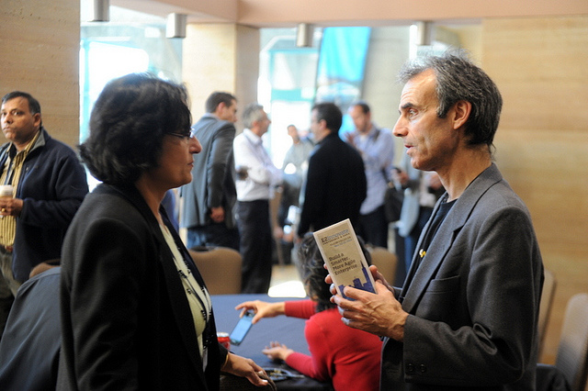
Refreshments, Pledge Card, Raffle

Slide 10
How to get started with OER Resources
Faculty Panel

Slide 11
Students and Faculty Experiences
Video 3:

Slide 12
De-mystifying the Technical Side of using OER
Instructional Technologists / Designers
The DE5 Team (MC, OC, VC)

Slide 13
Wrap-up,
Pledge Card Raffle Drawing,
Survey Completion

Slide 14
Happy Hour
Mingle and enjoy light refreshments
Chat with your colleagues using OER in small groups
Observe their OER supported Canvas Courses
Figure out – What is next?

