Slide 2
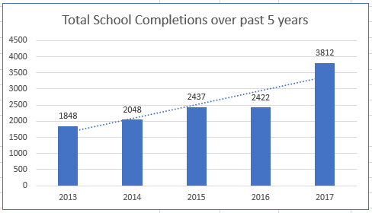

Slide 3
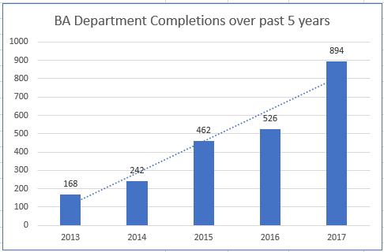

Slide 4
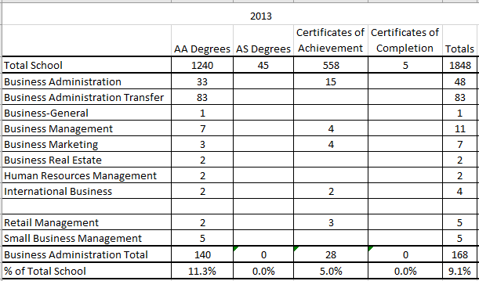

Slide 5
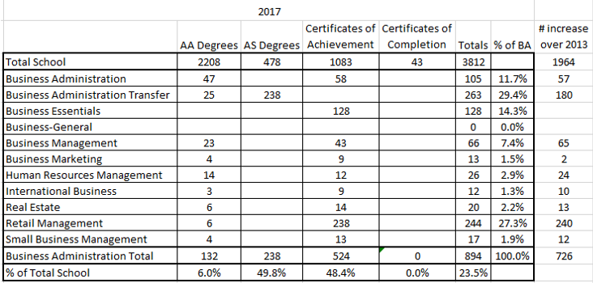

Slide 6
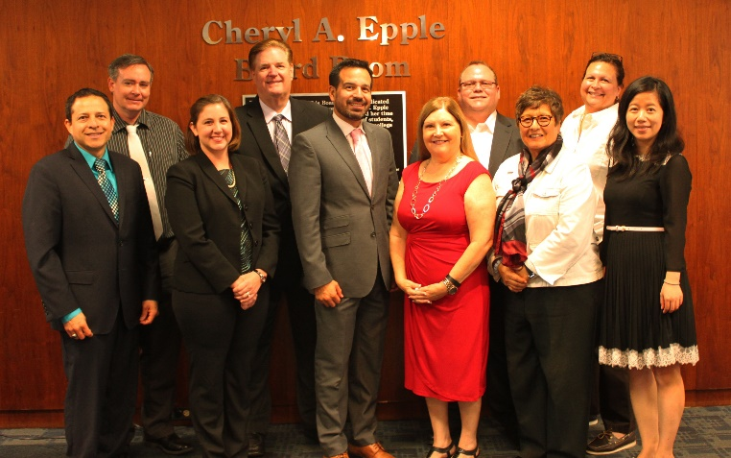
It starts with good people: DL/OER Team Representatives
Left to right in team photo:
Jerry Ramos (Business Administration Instructor)
Patrick O’Donnell (Director of Information Technology)
Wendy Wright (Business Administration Instructor)
Bob Livingston (Business Administration Instructor/Program Manager)
Jose Fierro (President/Superintendent)
Renee DeLong (Dean of Counseling Services)
David Gunn (Multimedia Production Specialist II)
Cindy Moriarty (Business Administration Instructor/Department Chair)
Stephanie Murguia (Dean of Admissions and Records)
Jianli Hu (Business Administration Instructor/Department Co-Chair)

Slide 7
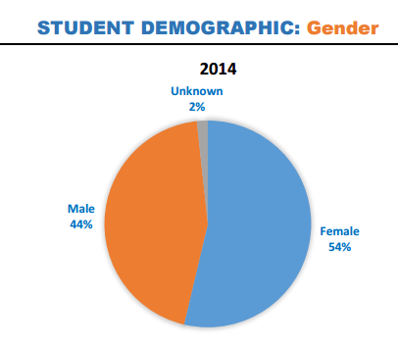
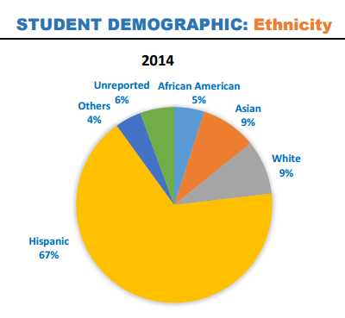
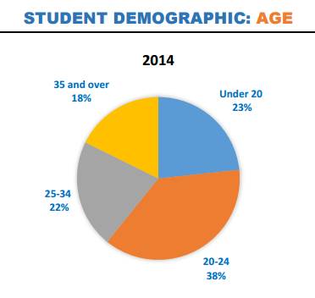
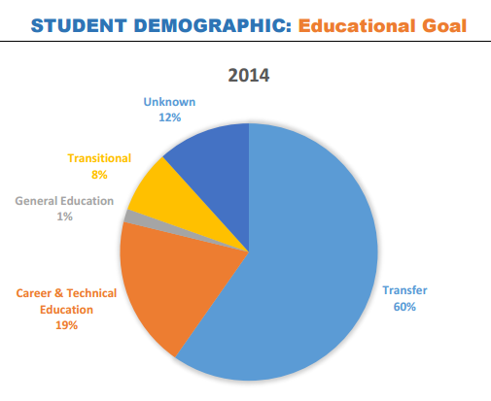
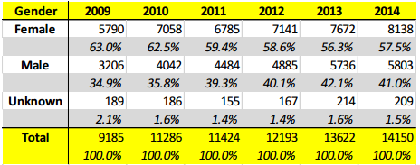
Our Students

Slide 8
Our Students
Cerritos College is a federally designated Hispanic Serving Institution.
Cerritos College recently ranked second in the state for Mexican-American/Latino student transfers to California State Universities.
69% of our 24,388 students in Fall 2015 were Hispanic, 7% Asian, 3% African American, and 6% Caucasian.
85% of incoming students are the first in their families to attend college.

Slide 9
Open Education Resources (OER)
At the suggestion of M.L. Bettino, our Innovation Center Director at the time, the Business Administration (BA) Department did a pilot study in 2008-09 using OER textbooks.
The results were very encouraging. Student retention rose 7.58% from 67.4% to 75.2%.
By Fall of 2010, 10 OER textbooks had been adopted for use in 39 class sections as the primary or supplemental textbook.

Slide 10
Open Education Resources (OER)
As more and more OER textbooks and materials were adopted, student retention and completions continued to increase.
Retention:
Fall/Spring 2008-09 67.4% (Pre-OER)
Fall/Spring 2009-10 75.2%
Fall/Spring 2013-14 80.3%
Fall/Spring 2014-15 83.4%
Spring 2016 86.7%

Slide 11
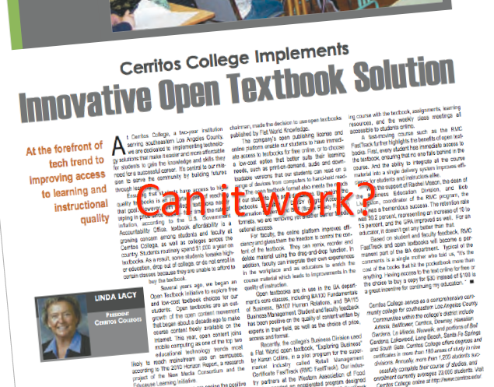
Open Education Resources (OER)
In 2011, we participated in a project with Lumen Learning called the Kaleidoscope project. The focus was on improving the success of at-risk students.
Ten high-enrollment general education courses in biology, chemistry, math, reading, English, business and psychology were developed using OER.
The project was chosen as a Campus Technology Innovator by Campus Technology magazine (2012).

Slide 12
Open Education Resources (OER)
Around 2014, the OER initiative began to have problems with scaling and sustainability.
The OER materials were becoming dated and we were using more and more of them.

Slide 15
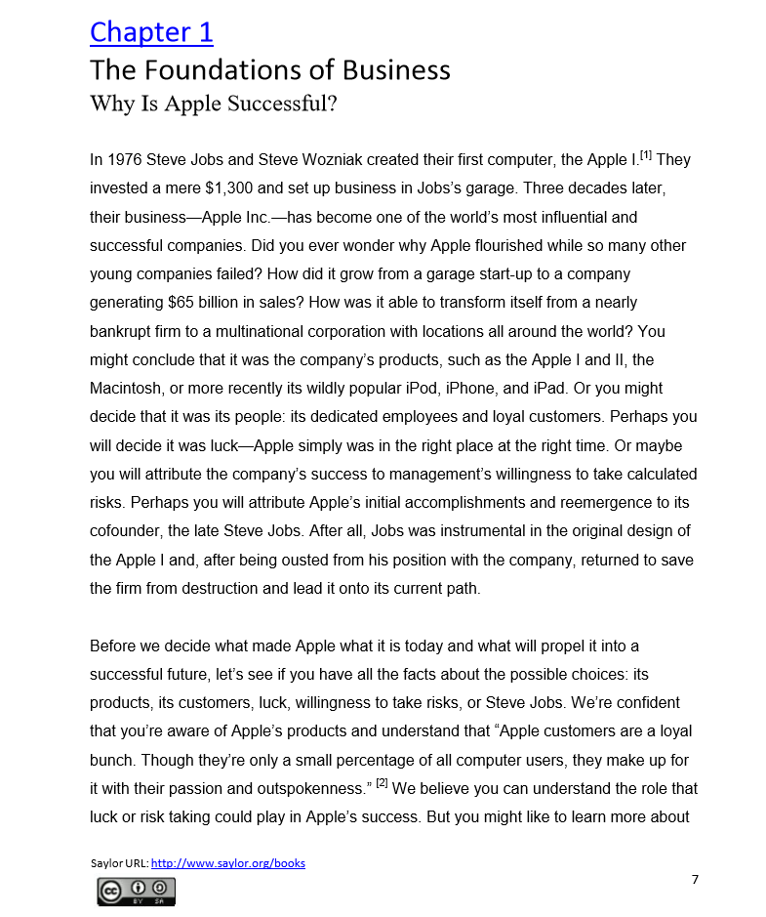

Slide 16
Open Education Resources (OER)
Lumen Learning provided the solution. The OER materials were moved into the Lumen Learning Candela Library providing the students with many more options to access the materials.
With the additional resources of Lumen Learning, keeping the OER materials up to date will be much more achievable.

Slide 17
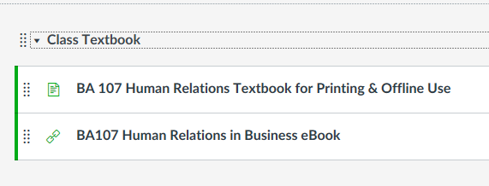
Open Education Resources (OER)

Slide 18
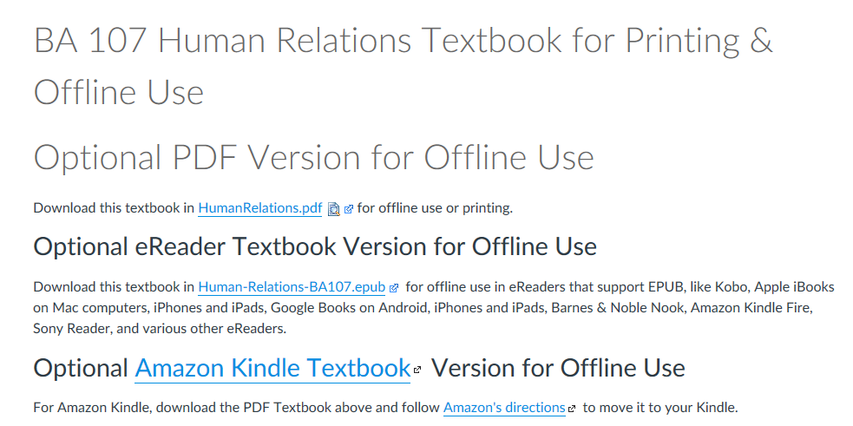
Open Education Resources (OER)

Slide 19
Digital Learning (DL)/Open Education Resources (OER)
What does the future look like?
We are working with Lumen Learning in the development of what we consider to be our next generation of OER – combining OER and digital learning (DL) using a digital courseware system Lumen calls “Waymaker.”
By partnering with Lumen Learning using Waymaker we gain expertise in content customization, curriculum alignment, assessment design, and delivery associated with building, editing, and adapting our pre-existing materials for our programs.

Slide 20
DL/OER
By the end of this year, we will have 3 more OER textbooks.
This will make 6 of our 8 programs in Business Administration 100% OER.
The majority of our courses will be moved into Waymaker this year.
Much is yet to be explored using DL/OER.

Slide 21
Resources

Slide 22
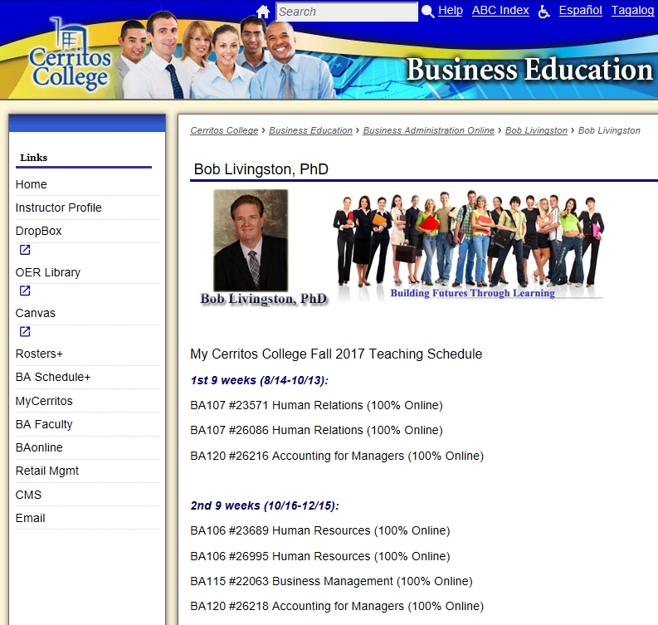

Slide 23
https://opentextbc.ca/

Slide 25
https://www.merlot.org/merlot/index.htm

Slide 26
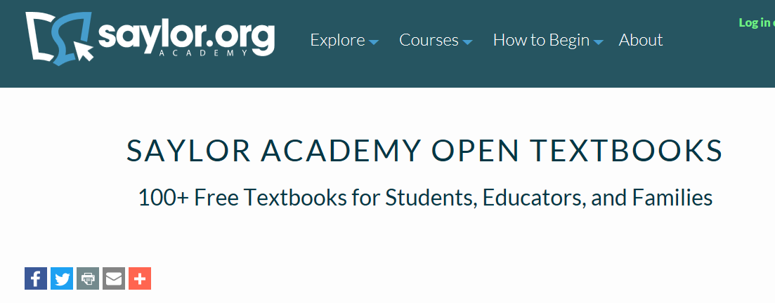
https://www.saylor.org/books/

Slide 27
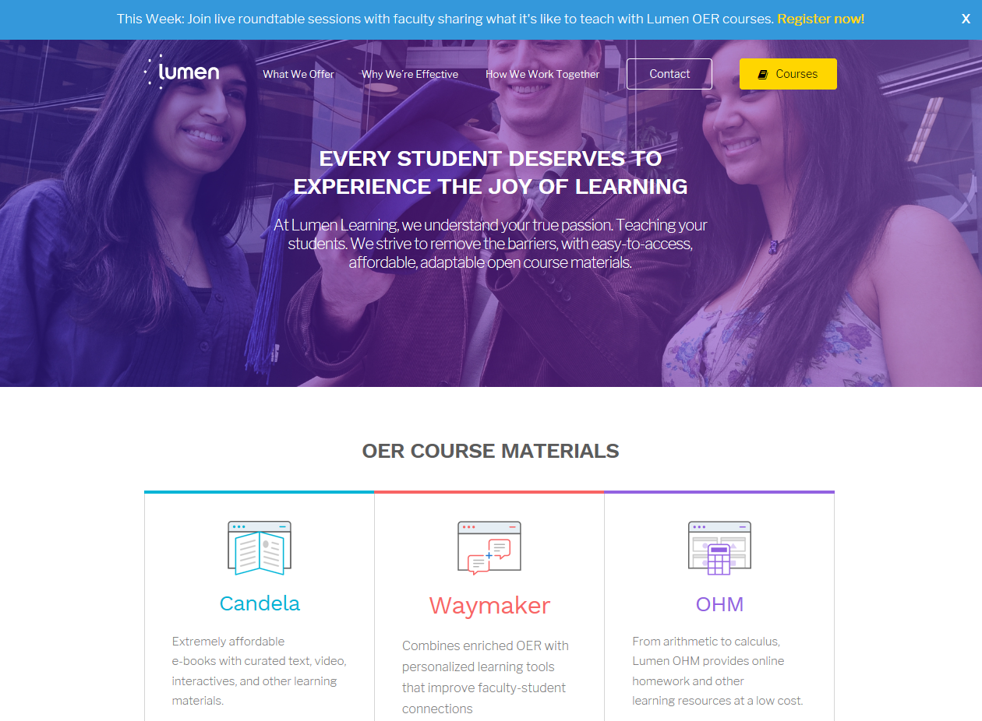

Slide 28
http://lumenlearning.com/what/candela/

Slide 29
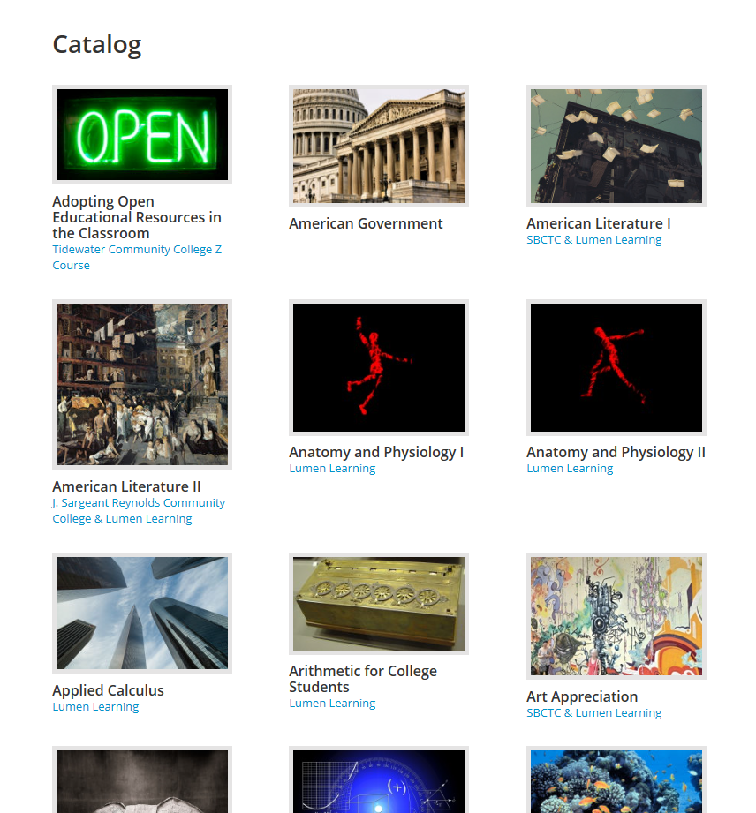
https://courses.lumenlearning.com/catalog/lumen

Slide 30
http://lumenlearning.com/what/waymaker/

Slide 31
https://openstax.org/

Slide 32
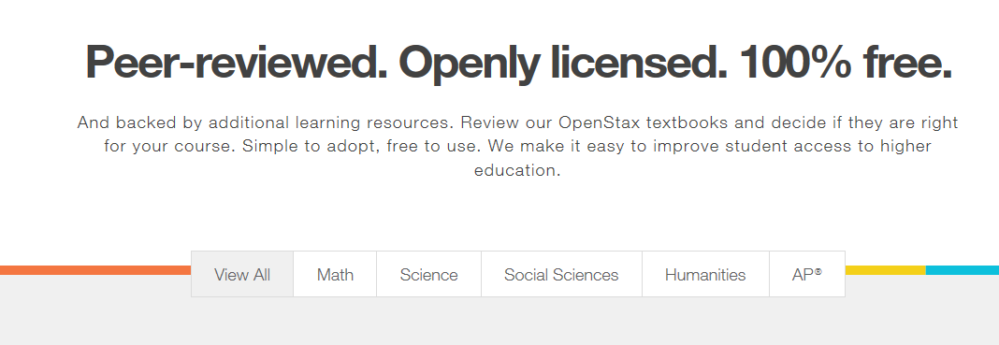

Slide 33
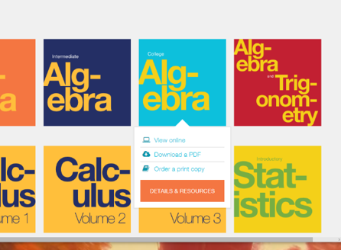

Slide 34
Become a student of OER

Slide 35
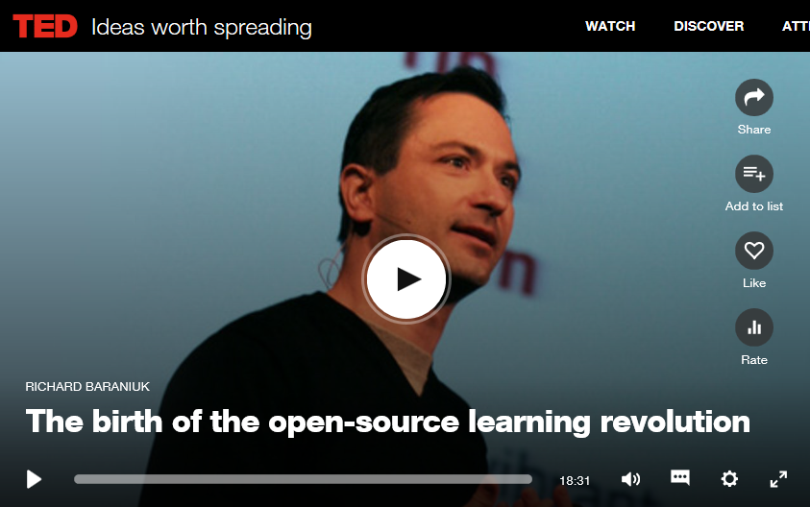
https://www.ted.com/talks/richard_baraniuk_on_open_source_learning

Slide 36
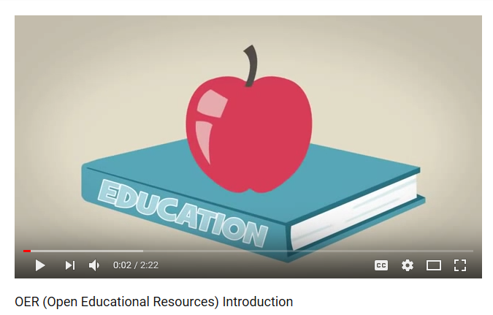
https://www.youtube.com/watch?v=ZFeyCc6we-s

Slide 37
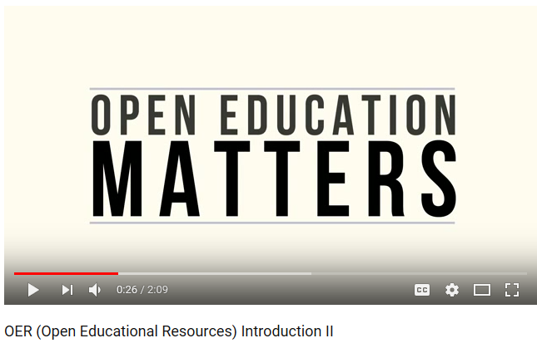
https://www.youtube.com/watch?v=Yfl1B6Qmp5g

Slide 38
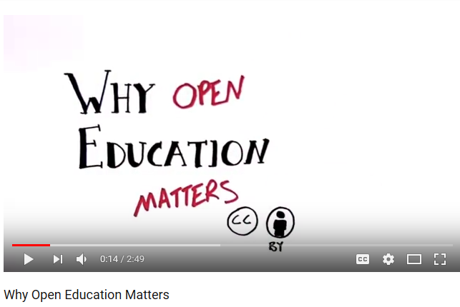
https://www.youtube.com/watch?v=cHQp33rbg5k

Slide 39
https://www.youtube.com/watch?v=Hkz4q2yuQU8&feature=youtu.be

Slide 40
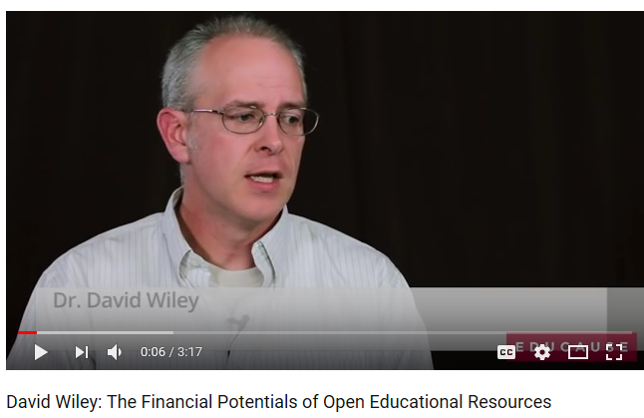
https://www.youtube.com/watch?v=Al_80-61kMw

Slide 41
https://www.youtube.com/watch?v=YM-oyzgkPx0

Slide 42
We are saving our students about
$1 million per year

Slide 43
THE BEST WAY TO Become a student of OER cccoer-advisory@googlegroups.com
The CCCOER-Advisory listserve is a public discussion list intended for community college faculty, librarians, instructional designers, administrators, and other educators who are interested in open education policy, practices, and resources.

Slide 44
Hi Lisa,
This won't be immediately useful but Josh Bolick, Maria Bonn, and Will Cross are developing an OER for library science. You can see their successful IMLS grant proposal here for additional details:
https://www.imls.gov/sites/default/files/grants/lg-72-17-0132-17/proposals/lg-72-17-0132-17-full-proposal-documents.pdf
Paige Mann
Scholarly Communications Librarian
University of Redlands

Slide 45
Good Morning,
I am also looking for materials and particularly an OER textbook on Western Civilization to 1650.
Thanks,
Annie Fox

Slide 46
Contemporary literature, humanities and popular culture are a challenge. There are some free/open access materials at places like archive.org, but not much in terms of modern works. We have leveraged our library collections to provide access to some titles to students at no cost. Novels, poetry and other creative works are the livelihood of their creators. I liked the response from Paige about using the Fair Use doctrine to assign chapters/sections of works instead of the entire book. This exposes students to more variety and will hopefully encourage them to read some of the complete books.
Regards, Preston
Wm. Preston Davis, Ed.D.
Director of Instructional Services
Northern Virginia Community College

Slide 47
Here are some thoughts on this thread. Some you may agree with and others not, but I hope it helps the conversation.
Rich Hershman, NACS
Loan programs. A program structured that way supplying books (print or digital) for a specific class if acquisition is ultimately funded through tuition and fees they would fall under federal cash management regulations for financial aid. Doesn't mean a rental/loan program like you describe can't be done, but would have to follow the regulations, which includes the ability of a student to opt out of the cost of the program and institutional documentation its meeting the requirements.

Slide 48
Fair Use. On the comment about using entire chapters, that sounds like stretching fair use and I would approach it carefully. A course packet with appropriate permission if its low cost could present savings over requiring entire books if only one or two chapters are being used, and also address problems students see when they are required to purchase something that is not fully utilized in the class.
Digital versus print novels. The research seems pretty clear for novels print is a better medium for most readers, unless you have a dedicated e-reader which most students don't have and rely more heavily on mobile phones and laptops.

Slide 49
Classic lit considerations. About 8 years ago NACS piloted in the U.S. and Canada at about 60 institutional college stores classic lit tittles that were in the public domain creating enhanced epub versions for free.
https://www.oerconsortium.org/tag/ebook/
Interestingly we saw a lot of push back from faculty because either they didn't like the particular translation or wanted the front material of a particular version to help their students understand the text.
https://www.aaccbooks.com/site_freeetextbooks.asp?

Slide 50
Overall picture of cost for the classes.
As you know novels and some trade titles are significantly cheaper in most cases than textbooks, though there are some exceptions. And such materials are normally heavily discounted from the SRP and can be found in the secondary market for significantly less cost. So there should be a cost benefit analysis in considering the hurdles and costs, benefits and trade offs in considering options here when it comes to modern literature.

Slide 51
Defining zero cost textbook degrees so narrowly I would argue becomes counter productive to learning.
Certainly the proposals and programs making college tuition free are not taking this approach that some are taking with z degree textbook initiatives. The tuition price and costs are still there, but the subsidies of various sources of financial grant aid bring that effective cost to the student to zero.
The average Humanities major (e.g., History, English, Religion) spent $471 in the 2016-2017 school year on required course materials. Compare the humanities student to a Health Professions & Related Clinical Sciences major who's average spending last year was $704 on required course materials, not to mention more expensive supplies and equipment.

Slide 52
Taking a quick look at the English courses at your school most of the modern lit novels in the courses I reviewed have print rental options below $8 for the term, while purchase options are not that much higher. The courses do also tend to have more expensive textbooks/anthologies, but in most of those cases the rental price is about $40. Looks like most of these courses have total costs at or below $50.
Considering financial aid in California (particularly at the community colleges) and the AOTC -assuming a non-traditional student hasn't exhausted the first four years- many students on financial aid taking lower cost courses are already at zero out of pocket textbook costs for those classes.

Slide 53
At $6-8 rental price on the novels and maybe even less in secondary market for used or buying off another student, not sure how much you should focus on these works versus the other required materials. That is not to say you should not be seeking out the use of OER or public domain novels, short stories or whatever openly licence or free to access copyrighted works or cheaper versions of the text if published by more than one publisher, but some context in overall costs would be helpful and how good the novel or trade title is in relation to the goals of the course. Also what level of choice do you want to give students in how they want to acquire and consume a work like a novel.
Hope this helps some.
Rich Hershman, NACS

Slide 54
Hi Lisa, a few reading resources in use in Oregon's colleges:
The Word on College Reading and Writing by Monique Babin, Carol Burnell, Susan Pesznecker, Nicole Rosevear, Jaime Wood
Lumen's Developmental Reading
Integrated Reading/Writing 115 course materials created in-house at PCC
Integrated Reading/Writing 90 course materials created in-house at PCC; Instructor guide: http://bit.ly/2oumRrX
FYI,
Amy

Slide 55
Hi Lisa,
We have an OER “Library Skills for Research” course which we’re in the process of updating, but I’ll share what we have currently.
Course packet in place of a textbook
Sampling of a series of videos:
Top 5 Things for Online Learners
Searching Library Databases
Prezi: Definitions
Information Timeline Practice
Citation Exercises: (We have the same for APA)
MLA Citation Scramble
Book Citation Scramble
Magazine Citation Scramble
Heather Blicher
ELI/Online Learning Librarian
Northern Virginia Community College
Extended Learning Institute (ELI)

Slide 56
Hi all, apologies for cross-posting.
An instructor is looking for open resources covering sociological perspectives on death in the US. Course description: "Introduces the student to the institution of death in the United States. From a sociological frame of reference, the student will study death as a system for dealing with the social processes of dying, death, and bereavement."
So far I have found:
Nursing Care at the End of Life - SUNY open textbook Death: A Personal Understanding - Annenberg video series, not openly licensed but terms of use may cover the course Any other ideas?
Thanks,
Amy Hofer
Coordinator, Statewide Open Education Library Services

Slide 57
Timeline:
The conversation began at 7:36 on Wednesday morning
It ended at 8:49 with Heather’s post
Then began again with Amy at 10:23 on the topic of death and bereavement

